Slide 1
Microprocessor and Computer Architecture(ELX 301)
BIT 3rd Semester
Er. Suraj Basant Tulachan
Assistant Professor

Slide 2
Unit 8: Memory Organization
Outline:
  8.1 Hierarchy of Memory System
  8.2 Primary and Secondary System
  8.3 Virtual Memory
  8.4 Cache Memory and Mapping Techniques
  8.5 Memory Management Hardware

Slide 3
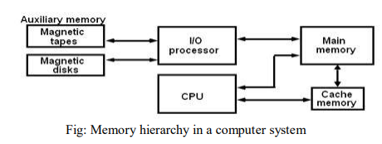
Unit 8: Memory Organization
Hierarchy of Memory System
Memory Hierarchy consist of all storage device employed in the computer system. It has relatively faster Main memory to the slow/high-capacity Auxiliary memory to an even smaller and faster Cache memory accessible to the high-speed processing logic.

Slide 4
Unit 8: Memory Organization
Hierarchy of Memory System
Main Memory:- It is a central storage unit that communicates directly with C.P.U and to Auxiliary memory devices through I/O Processor. It is the central storage unit in a computer system. It is a relatively large and is fast memory used to store programs and data during the computer operation.
Auxiliary Memory:- Auxiliary Memory are the memory unit that provides backup storage. It has large storage capacity and has low access speed. All other information is stored in auxiliary memory and transferred to main memory when needed.
Cache Memory:- The cache memory is relatively very small, relatively expensive, and has very high access speed. As Access time of CPU and main memory are different. Cache organization is concerned with the transfer of information between main memory and CPU.

Slide 5
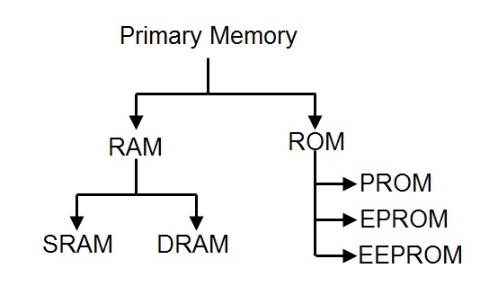
Unit 8: Memory Organization
Primary and Secondary Memory
Primary Memory:-Primary memory is also known as Main memory or Internal memory. Basically Primary memory is a segment of computer that can be accessed directly by processor. In a hierarchy of memory, primary memory have access time less than secondary memory and greater than cache memory. Generally, primary memory has a storage capacity lesser than secondary memory and greater than cache memory.

Slide 6
Unit 8: Memory Organization
Primary Memory
Read Only Memory is the long-term internal memory. ROM is “Non-Volatile Memory” that retains data without the flow of electricity. ROM is an essential chip with permanently written data or programs. It is similar to the RAM that is accessed by the CPU. ROM comes with pre-written by the computer manufacturer to hold the instructions for booting-up the computer.
There is generally Three broad type of ROM:
• PROM(Programmable Read Only Memory):
PROM stands for programmable ROM. It can be programmed only be done once and read many. Unlike ROM, PROMs retain their contents without the flow of electricity. PROM is also nonvolatile memory. The significant difference between a ROM and a PROM is that a ROM comes with pre-written by the computer manufacturer whereas PROM manufactured as blank memory. PROM can be programmed by PROM burner and by blowing internal fuses permanently.

Slide 7
Unit 8: Memory Organization
Primary Memory
EPROM (Erasable Programmable Read Only Memory):
This memory type retains its contents until it exposed to intense ultraviolet light that clears its contents, making it possible to reprogram the memory.
EEPROM (Electrically Erasable Programmable Read Only Memory):
EEPROM can be burned (programmed) and erased by first electrical waves in a millisecond. A single byte of a data or the entire contents of device can be erased. To write or erase this memory type, you need a device called a PROM burner.

Slide 8
Unit 8: Memory Organization
Primary Memory
RAM (Random Access Memory)
The Word “RAM” stands for “Random access memory” or may also refer to short-term memory. It’s called “random” because you can read store data randomly at any time and from any physical location. It is a temporal storage memory. RAM is volatile that only retains all the data as long as the computer powered. It is the fastest type of memory.
There are generally two broad subcategories of RAM:
Static RAM: Static RAM is the form of RAM and made with flip flops and used for primary storage are volatile. It retains data in latch as long as the computer powered. SRAM is more expensive and consumes more power than DRAM. It used as Cache Memory in a computer system. As technically, SRAM uses more transistors as compared to DRAM. It is faster compared to DRAM due to the latching arrangement, and they use 6 transistors per data bit as compared to DRAM, which uses one transistor per bit.

Slide 9
Unit 8: Memory Organization
Primary Memory
• Dynamic Random Access Memory (DRAM):
It is another form of RAM used as Main Memory, its retains information in Capacitors for a short period (a few milliseconds) even though the computer powered. The Data is Refreshed Periodically to maintain in it. The DRAM is cheaper, but it can store much more information. Moreover, it is also slower and consumes less power than SRAM.
Secondary Memory:
Secondary memory is computer memory that is non-volatile, persistent and not immediately accessible by a computer or processor. It allows users to store data and information that can be retrieved, transmitted, and used by apps and services quickly and easily. Secondary storage is another name for secondary memory. Secondary memory is known as a Backup memory or Additional memory or Auxiliary memory. Hard Drive, SSD(Solid State Drive), Flash, Optical Drive, USB Drive are some examples of secondary memories in computer.

Slide 10
Unit 8: Memory Organization
Virtual Memory
Virtual memory is a technique for using the secondary storage to extend the apparent limited size of the physical memory beyond its actual physical size. It is usually the case that the available physical memory space will not be enough to host all the parts of a given active program.
Virtual memory gives programmers the illusion that they have a very large memory and provides mechanism for dynamically translating program-generated addresses into correct main memory locations. The translation or mapping is handled automatically by the hardware by means of a mapping table
Virtual memory system attempts to optimize the use of the main memory (the higher speed portion) with the hard disk (the lower speed portion).

Slide 11
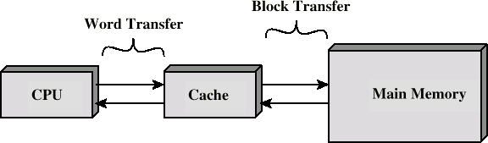
Unit 8: Memory Organization
Cache Memory
Cache memory is extremely fast associative memory between normal main memory and CPU.
The CPU uses cache memory to store instructions that are repeatedly required to run programs, improving overall system speed.
Cache memory increases fast access time.
When CPU needs to access contents of memory location, then cache is examined for this data.
    If present, get from cache (fast).
    If not present, read required block from main memory to cache, then deliver from cache to CPU.

Slide 12
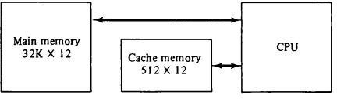
Unit 8: Memory Organization
Cache Memory Mapping Technique
Cache Mapping Technique is the process of transferring the data from main memory to cache is known as mapping process. The main memory can store 32K words of 12 bits each. The cache is capable of storing 512 of these words at any given time. For every word stored in cache, there is a duplicate copy in main memory. The CPU communicates with both memories. It first sends a 15-bit address to cache. If there is a hit, the CPU accepts the 12-bit data from cache. If there is a miss, the CPU reads the word from main memory and the word is then transferred to cache. There are three types of cache mapping techniques:
Associative Mapping
Direct Mapping
Set-Associative Mapping

Slide 13
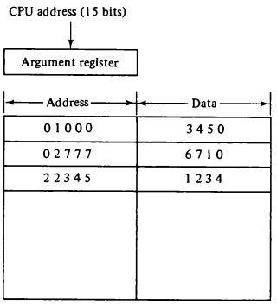
Unit 8: Memory Organization
Cache Memory Mapping Technique
Associative Mapping:-Associative memory is plays key role in Associative Mapping. Associative memory stores both the address and content (data) of the memory word. The diagram shows three words presently stored in the cache.
The address value of 15 bits is shown as a five digit octal number.
Its corresponding 12 bit word is shown as a four digit octal number.
A CPU address of 15 bits is placed in the argument register and the associative memory is searched for a matching address.
If the address is found, the corresponding 12 bit data is read and sent
to the CPU.

Slide 14
Unit 8: Memory Organization
Cache Memory Mapping Technique
Associative Mapping:-
If no match occurs, the main memory is accessed for the word.
The address-data pair is then transferred to the associative cache memory.
If the cache is full, an address-data pair must be displaced to make room for a pair that is needed and not presently in the cache.
The decision as to what pair is replaced is determined from the replacement algorithm that the designer chooses for the cache.
It is considered to be the fastest and most flexible mapping form.

Slide 15
Unit 8: Memory Organization
Cache Memory Mapping Technique
Direct Mapping:-
It is the simplest Cache Memory Mapping technique.
The CPU address of 15 bits is divided into two fields. The nine least significant bits constitute the index field and the remaining six bits the tag field.
Main memory needs an address that includes both the tag and the index bits. The number of bits in the index field is equal to the number of address bits in the cache memory.
The n bit memory address is divided into two fields: k bits for the index field and n-k bits for the tag field. The direct mapping cache organization uses the n bit address to access the main memory and the k bit index to access the cache.
Each word in cache consists of the data word and its associated tag. When a new word is first brought into the cache, the tag bits are stored alongside the data bits. When the CPU generates a memory request, the index field is used for the address to access the cache.
The tag field of the CPU address is compared with the tag in the word read from the cache. If the two tags match, there is a hit and the desired data word is in cache. If there is no match, there is a miss and the required word is read from main memory. It is then stored in the cache together with the new tag, replacing the previous value.

Slide 16
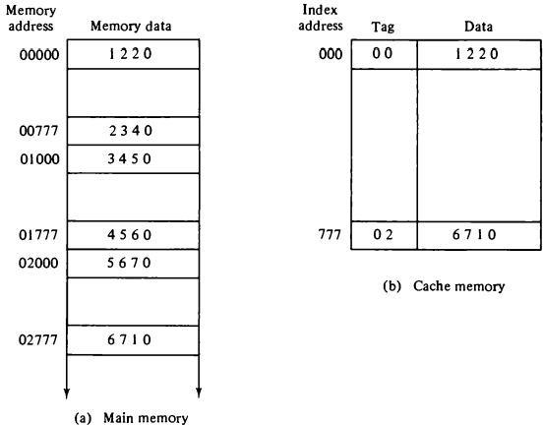
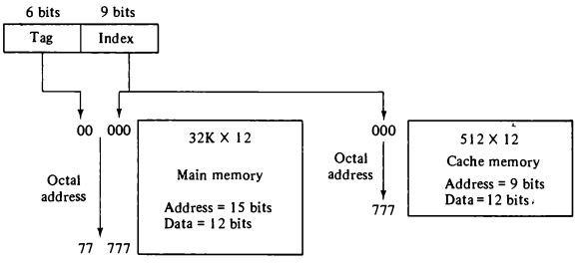
Unit 8: Memory Organization
Cache Memory Mapping Technique
Direct Mapping:- In Direct Mapping two words with the same index in their address but with different tag values cannot reside in cache memory at the same time.
Direct Cache Memory Mapping
Addressing relationships between main and cache memories.

Slide 17
Unit 8: Memory Organization
Cache Memory Mapping Technique
Set Associative Mapping:-
Set Associative mapping is an enhanced form of direct mapping where the drawbacks of direct mapping are removed.
Set associative cache mapping combines the best part of Direct and Associative cache mapping techniques.
Each word of cache can store two or more words of memory under the same index address.
A block of main memory can map to any line of the cache that is freely available at that moment.
Each data word is stored together with its tag and the number of tag-data items in one word of cache is said to form a set.

Slide 18
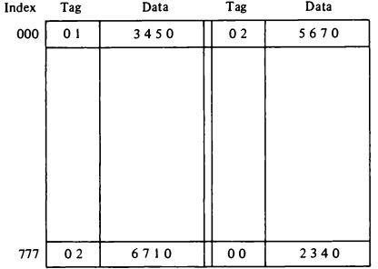
Unit 8: Memory Organization
Cache Memory Mapping Technique
Set Associative Mapping:-
The words stored at addresses 01000 and 02000 of main memory are stored in cache memory at index address 000. Similarly, the words at addresses 02777 and 00777 are stored in cache at index address 777.
When a miss occurs in a set associative cache
and the set is full, it is necessary
to replace one of the tag data items with a new value.
The most common replacement algorithms used are:
random replacement, first in first out (FIFO),
and least recently used (LRU).

Slide 19
Unit 8: Memory Organization
Memory Management Hardware:-
A memory management system is a collection of hardware and software procedures for managing various programs (effect of multiprogramming support) residing in memory. Basic components of Memory Management Unit (MMU) are:
A facility for dynamic storage relocation that maps logical memory references into physical memory addresses.
A provision for sharing common programs by multiple users.
Protection of information against unauthorized access.

Slide 20
THANK YOU

